Slide 1


NEURAL NETWORK
presented by:
k.kaviya

Slide 2
Convolution Neural Network(CNN)

Slide 3
INTRODUCTION
What is CNN
•It is a class of deep learning.
•In this we do image recognition,images
classification and object detection.
•It is similar to neural network.

Slide 4
CNN Components
Convolution layer
Pooling layer
Fully connected layer

Slide 5
Convolution layer
INPUT
•An image is a matrix of pixel values.
•Each pixel range from 0 to 255.
•two images :
1. black & white
2. RGB image

Slide 6
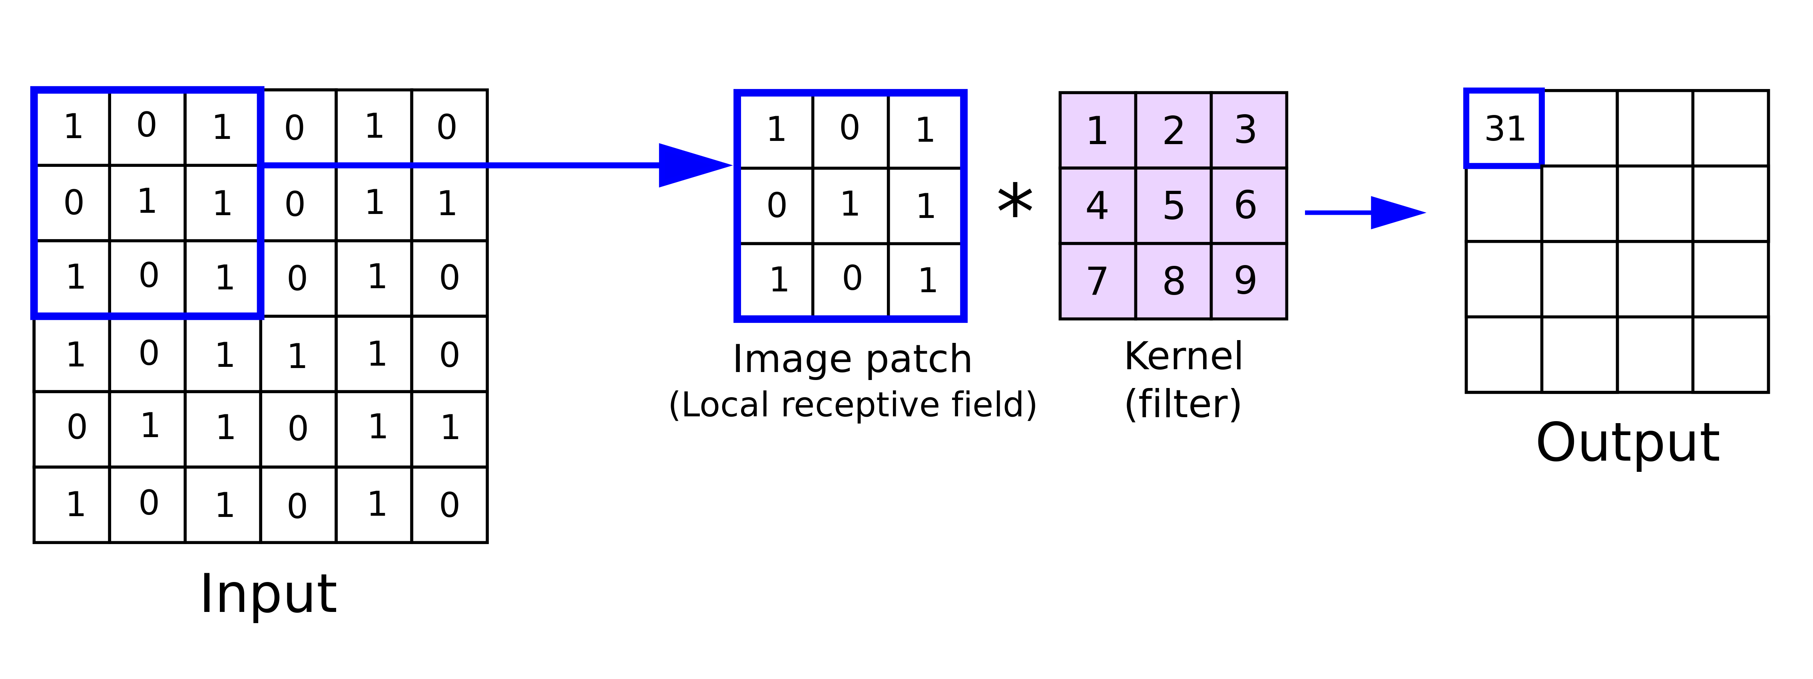
CONVOLUTION
The primary purpose of convolution in case of a CNN is to extract features from the input image.
Formula=n-f+1

Slide 7
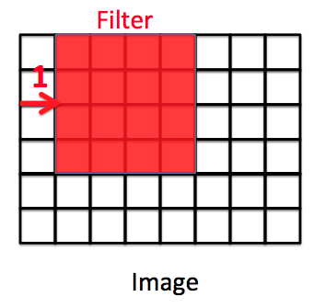
STRIDE
Stride is the number of pixels by which we slide our filter matrix over the input matrix.

Slide 8
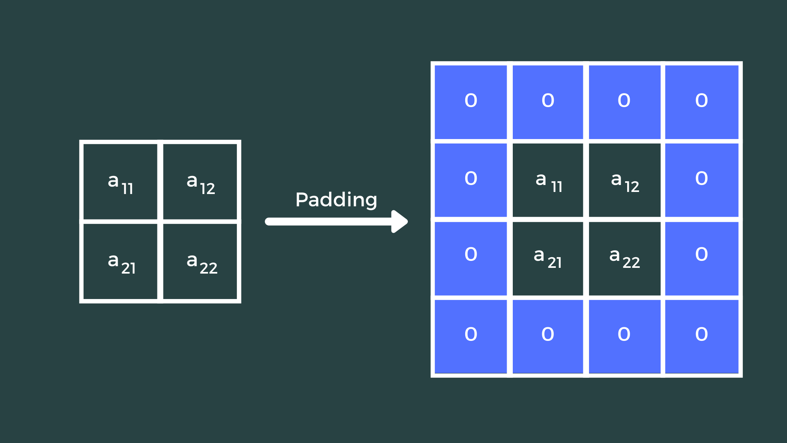
PADDING
• Protecting the image by adding another layer on the top.
•Building a compound among the images.
•n+2p-f+1

Slide 9
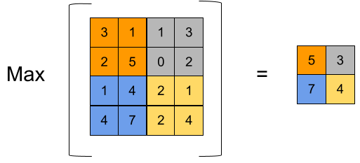
POOLING LAYER
To extract more and more clear information
The pooling operation involves sliding a two-dimensional filter over each channel of feature map and summarising the features lying within the region covered by the filter.
Types :
1.average pooling
2.min pooling
3. max pooling

Slide 10
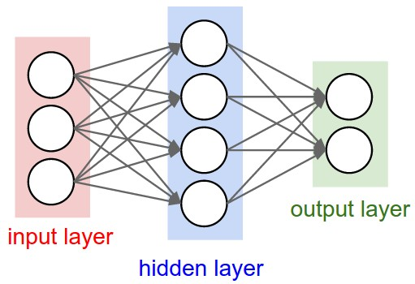
FULLY CONNECTED LAYER
A traditional multi-layer Percepter.
The every neuron in the previous layer is connected to every neuron on the next layer .
The purpose of the fully connected layer is to use the high level features for classifying the input image into various classes based on the training dataset.

Slide 11
RNN(Recurrent Neural Network)

Slide 12
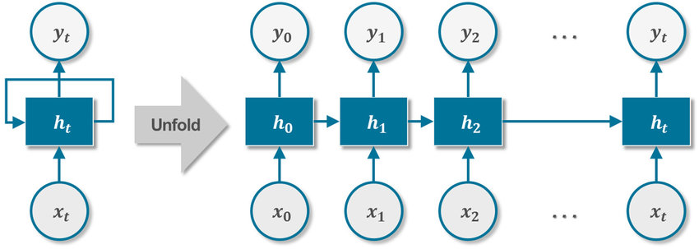
What is RNN?
RNN is a simple neural network when data is sequential like Time Series Data and Text data.
In RNN the output from previous step is fed as input to the current step.
It is mainly used in NLP
The important feature in RNN is Hidden State.

Slide 13

RNN Works:
It consist of multiple fixed activation function units one for each time step
Formula for calculating current state
ht -> current state
ht-1 -> previous state
xt -> input state

Slide 14
Usecases:
Auto complete
Translation
Name entity Recognition • X - Statement • Y – Person Name Ex: Prasanth bought 1000 shares of Tesla Inc
Sentimental analysis

Slide 15
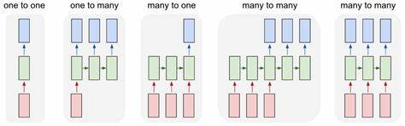
Types of RNN
One to One
One to Many
Many to One
Many to Many

Slide 16
Applications:
Language Modelling and Generating Text
Speech Recognition
Machine Translation
Image Recognition, Face detection
Time series Forecasting

Slide 17
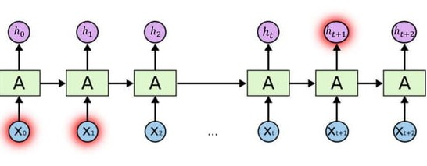
Long Short Term Memory:
LSTM is a type of RNN
LSTM do not have large gap problem.
LSTM can by default retain the information for a long period of time.
It is used for processing, predicting, and classifying on the basis of time-series data.
LSTMs address this problem by introducing a memory cell, which is a container that can hold information for an extended period of time.

Slide 18
Memory Cell:
The memory cell is controlled by three gates:
•The input gate
•The forget gate
•The output gate
These gates decide what information to add to, remove from, and output from the memory cell.

Slide 19
Difference between RNN and LSTM:
Parameters | RNN | LSTM
Structure | Simple | More Complex
Training | Can be difficult | Can be more difficult
Performance | Good for simple task | Good for complex task
Hidden State | Single | Multiple(Memory cell)
Gates | None | Input, Output,Forget
Ability to retain long term dependencies | Limited | Strong

Slide 20
THANK YOU

